Slide 1


Hospitalize
Healthcare is a right,not a privilege

Slide 2





Meet Our Team
JEGATHEESWARAN T
KATHIR K S
SABARI RAJ N
SANJEEVI V
II-CSE-A
FULL STACK DEVELOPER
II-ECE-B
BACKEND DEVELOPER
II-IT-C
UI/UX DESIGNER
II-IT-C
BACKEND DEVELOPER

Slide 3



PROBLEM STATEMENT
Health care reform is currently one of the most divisive issues.Though with the growth of technology,a software for uniting all hospital in a single platform is not adaptable by hospitals and patients.The complaint portal is not available for patients to raise their issues to the concerned authority.

Slide 4
AREAS OF FOCUS
UNITING HOSPITALS UNDER SINGLE APP
MAINTAINING THE PAST RECORDS
01
This app finds a solution to unite all the hospitals in a single app by updating the total number of available beds, doctors present in the particular time at particular hospital.
02
This app helps to maintain the past medical records(including prescription details,other medical related reports,etc.,.). The appointment with the doctor can be done with the help of this app and the medical records can be accessed by him with the prior permission of the patients.
RAISING COMPLAINT
ORGANISING THE PAYMENT
03
The uniqueness of this app is that it contains complaint portal. The complaints raised by the patients are send to respective authority and necessary actions taken accordingly.
04
The payments for the medical expenses can be done with this app.This helps the government to check the original pricing of the hospital.

Slide 5

TECH STACK
USE CASE
LANGUAGES USED: HTML,CSS,ReactJS,Node JS
DATABASE: MYSQL
API:Google Maps API
PATIENT LOGIN
HOSPITAL LOGIN
Booking Slots
Respond to user
request
CENTRALISED
DATABASE
Maintaining health record
Raising Compliant
Updating
details
Payment Processing

Slide 6
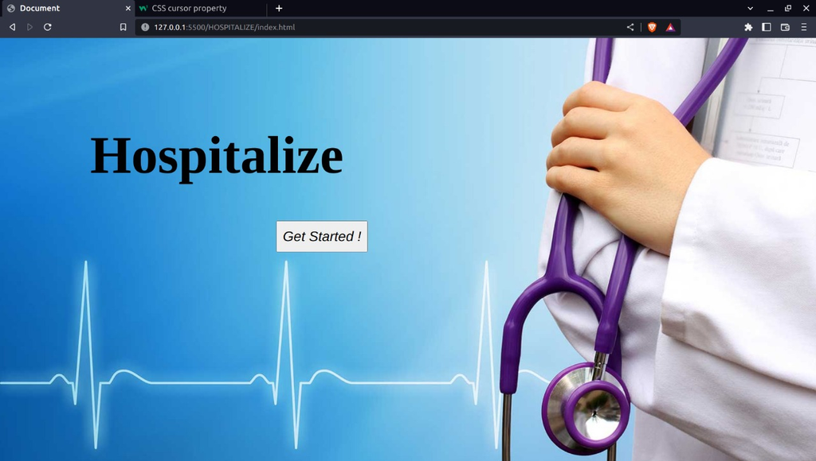
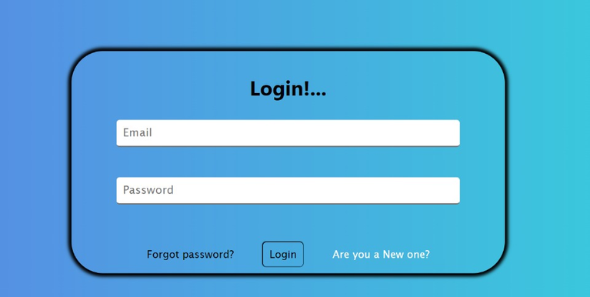
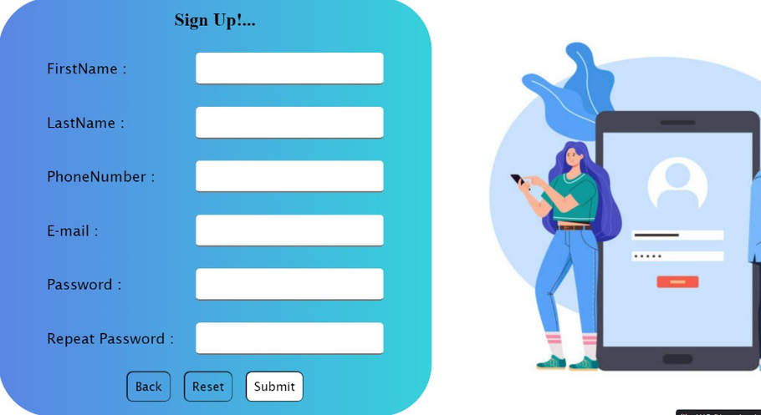
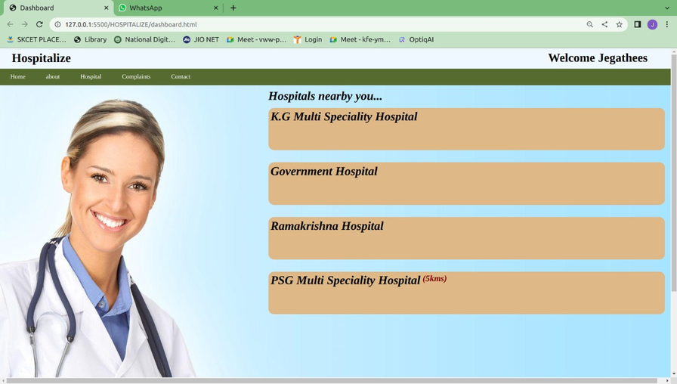
PROTOTYPE SCREENSHOT

Slide 7
CONCLUSION
Everyone needs to be well informed and concerned about the quality of care. Everyone means patients and their families, consumer agents and advocates, health professionals, administrators of health plans and facilities, purchasers of health care services, and policymakers at all levels.
Youtube PPT presentation link:
https://youtu.be/ai1ur-St4Zw
Canva PPT Link:
https://www.canva.com/design/DAFQzEu0rsQ/SpIss8f86zai1y3Eb60GTg/edit?utm_content=DAFQzEu0rsQ&utm_campaign=designshare&utm_medium=link2&utm_source=sharebutton

Slide 8

Thank You

